Slide 1
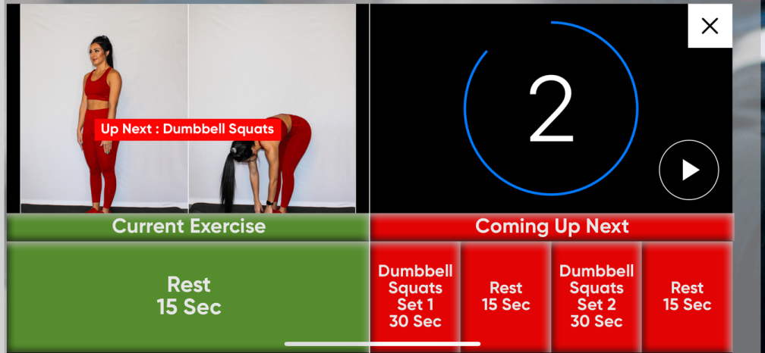
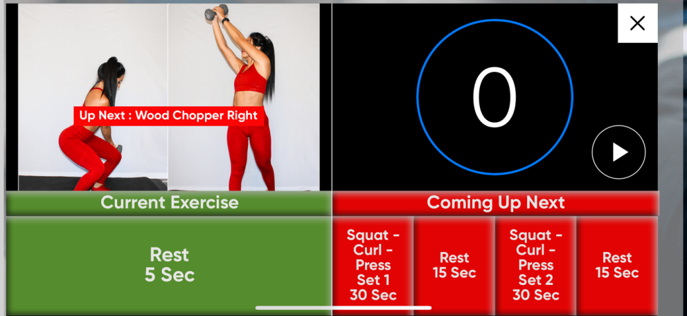
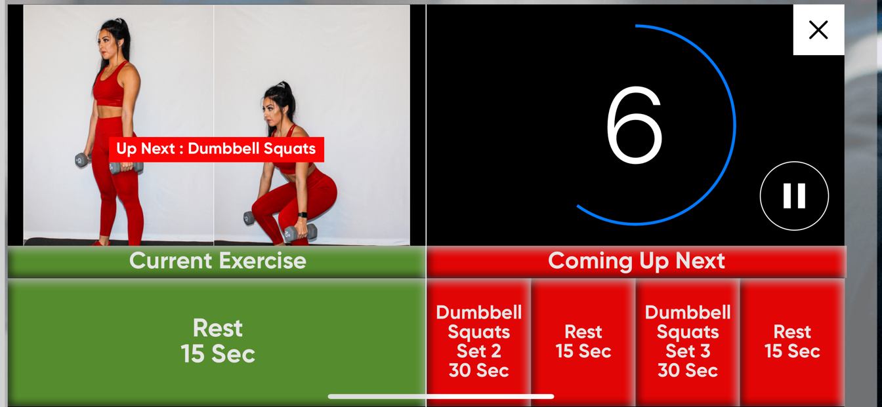
Fitness Protection 15 App Revisions 2022
Correct Workouts (Make sure each workout matches the sequence on the New Proper Form PDF that I will provide) Only a few out of sequence now.
-Need to upload new Proper Form PDF Sheet

Slide 2
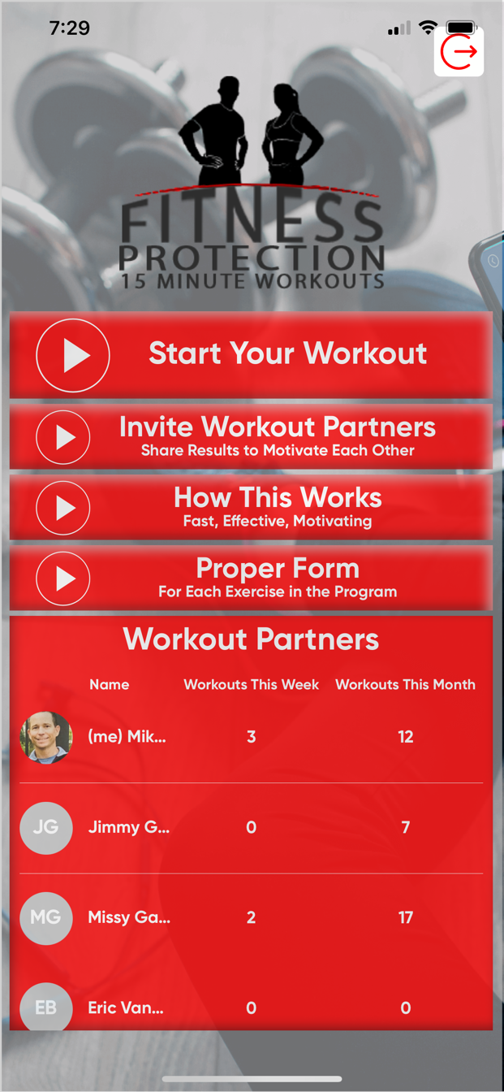
2. My Account Button
(change to better Icon)
Needs to:
Save your profile each time
Easy to edit your profile / change picture
Log in for the App is your email - Password is cell #
Make sure you can easily log back in without an error

Slide 3

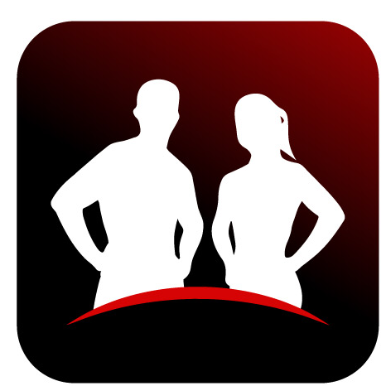
Invite Workout Partners Functions
If you invite multiple friends or get invited by a friend, your name only shows up once on the home screen
Make sure the invite connects – even if you already have the app downloaded
Ability to remove workout partners
Workout Partners Counter – Needs to count workouts per week starting Mon 12:01am thru Sun 11:59pm
4. Update New Logo and App Icon and App Screen Buttons (3D Play buttons) (all the same size)
Updated Logo
Updated Icon

Slide 4
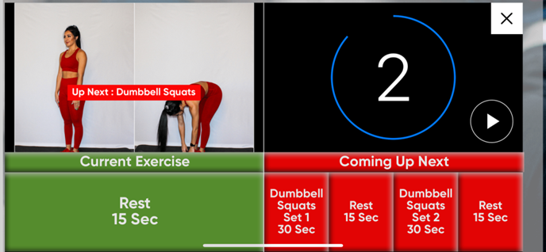

5. Repeats “You have finished the 15 minute workout” a second time after you push play on the Fat Blaster Bonus. Remove that extra voice repeat
6. Make the rest period before the Fat Blaster Bonus starts (10 Seconds). Right now it is 5 seconds)
7. Fix Admin Website
More User Friendly
Change or Add Workouts easily
Manage Users Easily.
Shows User status (active, deleted etc)
Easily send messages (text and email to users)
8. Workouts per week count starts Monday – Sunday
9. Run Ads on App – During Rest Periods
Need to enable Ads for App stores
Set up in both Google Play and Apple App
Stores and make sure they are working
Properly.
Run Ads During Rest Periods

Slide 5


